Slide 1
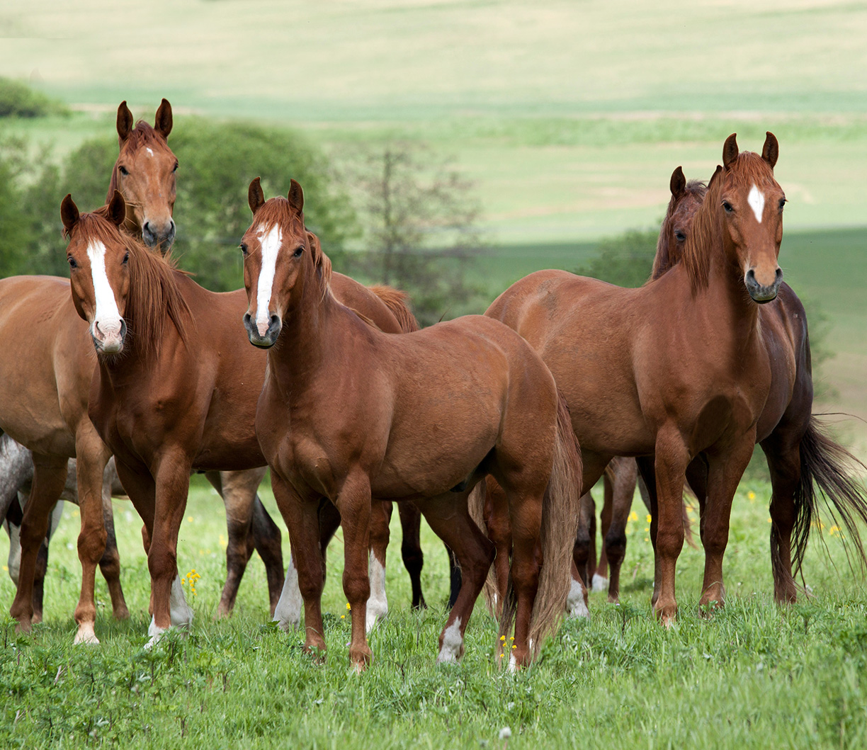
NUTRITION
HN
HORSE

Slide 2
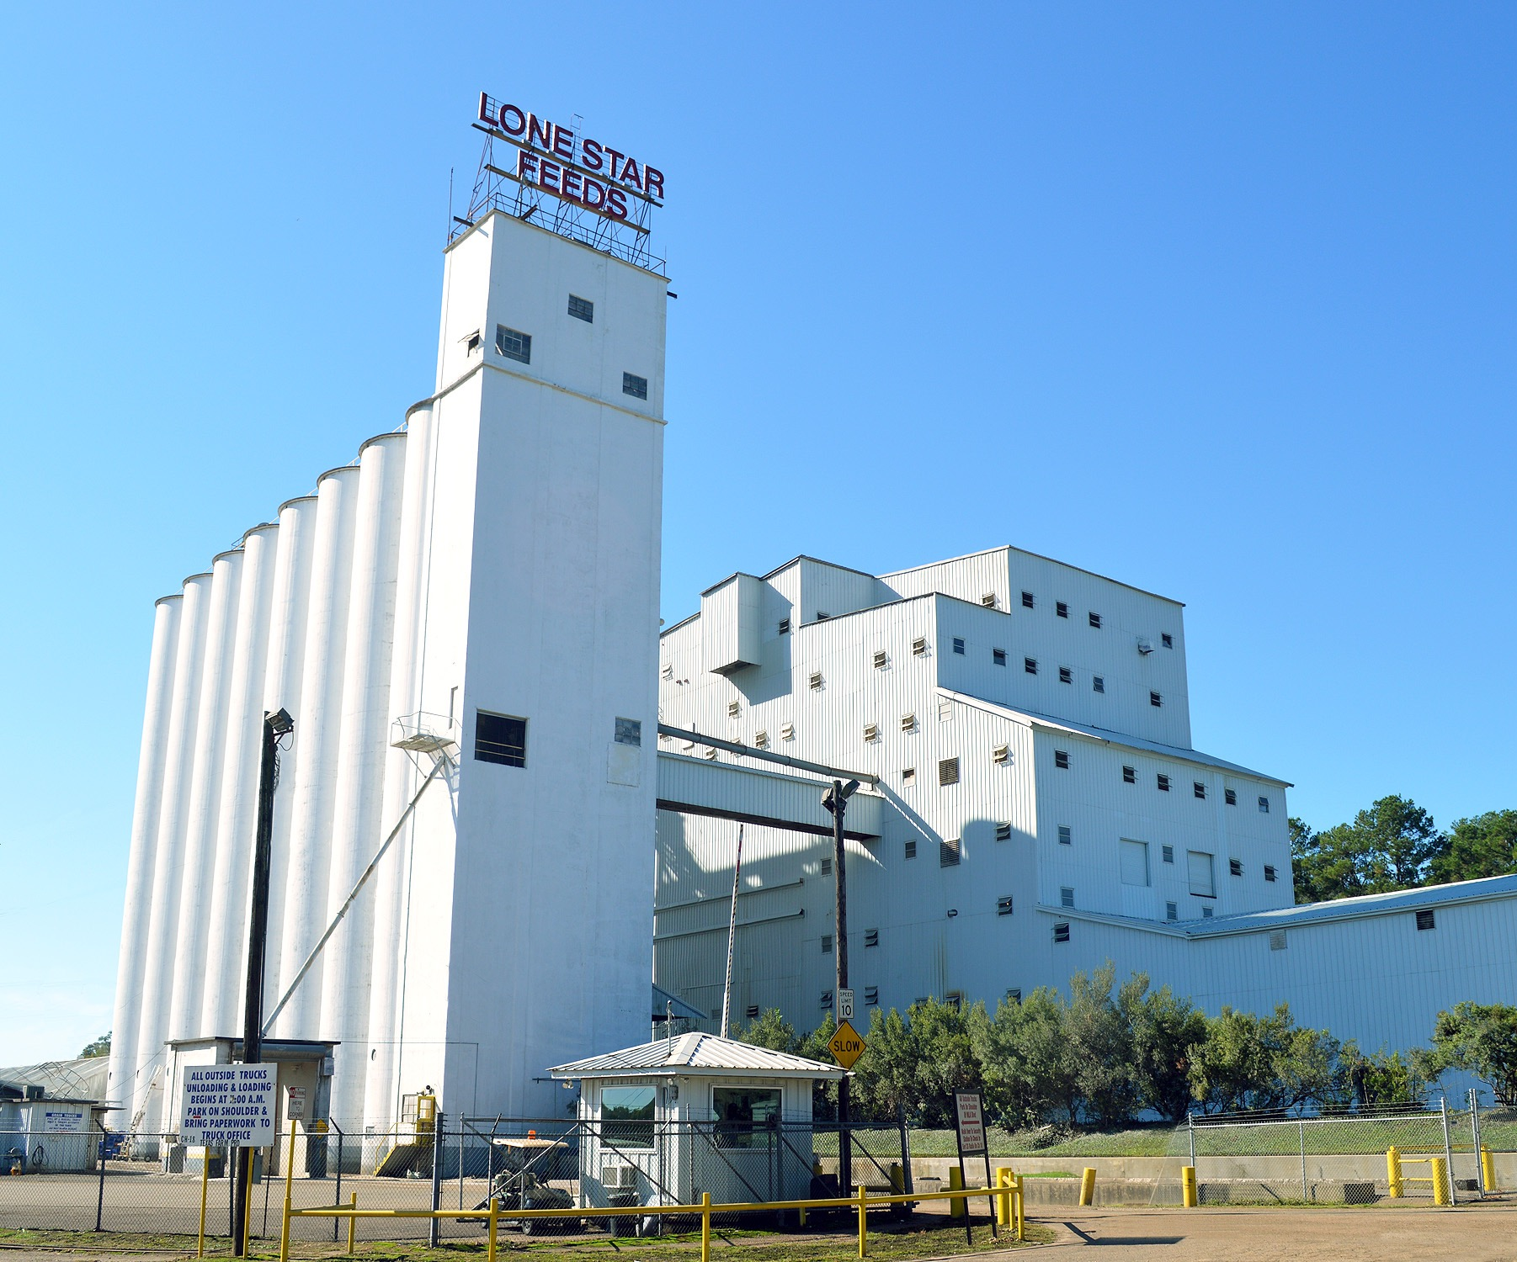
LONE STAR FEED
HN
Established by M.S. Wright in 1930
Produces a wide range of complete horse and cattle feeds, as well as feeds for chickens, sheep, pigs, and goats

Slide 3
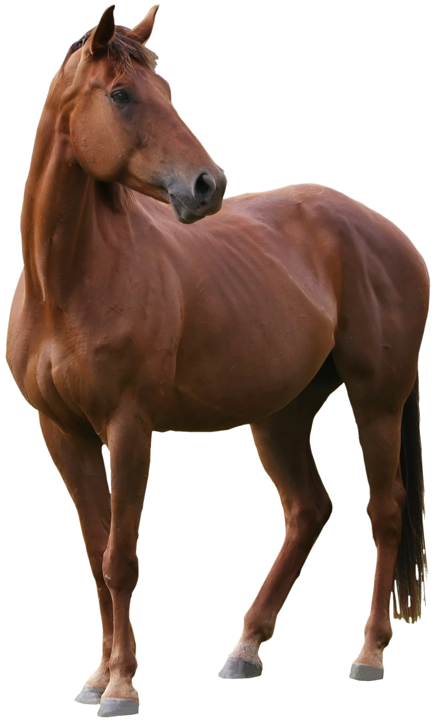
HORSE NUTRITION
HN
Introduction
Non-Ruminant Herbivores
The equine digestive system is unique because it is designed to process small amounts of food frequently and convert them into nutrients that can be absorbed and produce energy.
The horse’s digestive system is more prone to problems than others. This is not due to poor design but is the result of humans changing what nature intended for the horse.
A large portion of the horse’s diet is roughage.
Humans expect more out of horses than they can produce from eating forages alone.
We now have to supplement the forage with feed for the horses to reach their maximum potential.
To properly maximize the horse's potential, we must know what the nutrient requirements of the animal is.
  Reproduction
  Speed
  Growth
  Attractiveness

Slide 4
DIGESTIVE SYSTEM
HN

Slide 5

NUTRIENT REQUIREMENTS
HN
Protein 6-12%
Energy 86-93%
Minerals & Vitamins 1-2%
Water
Forages

Slide 6
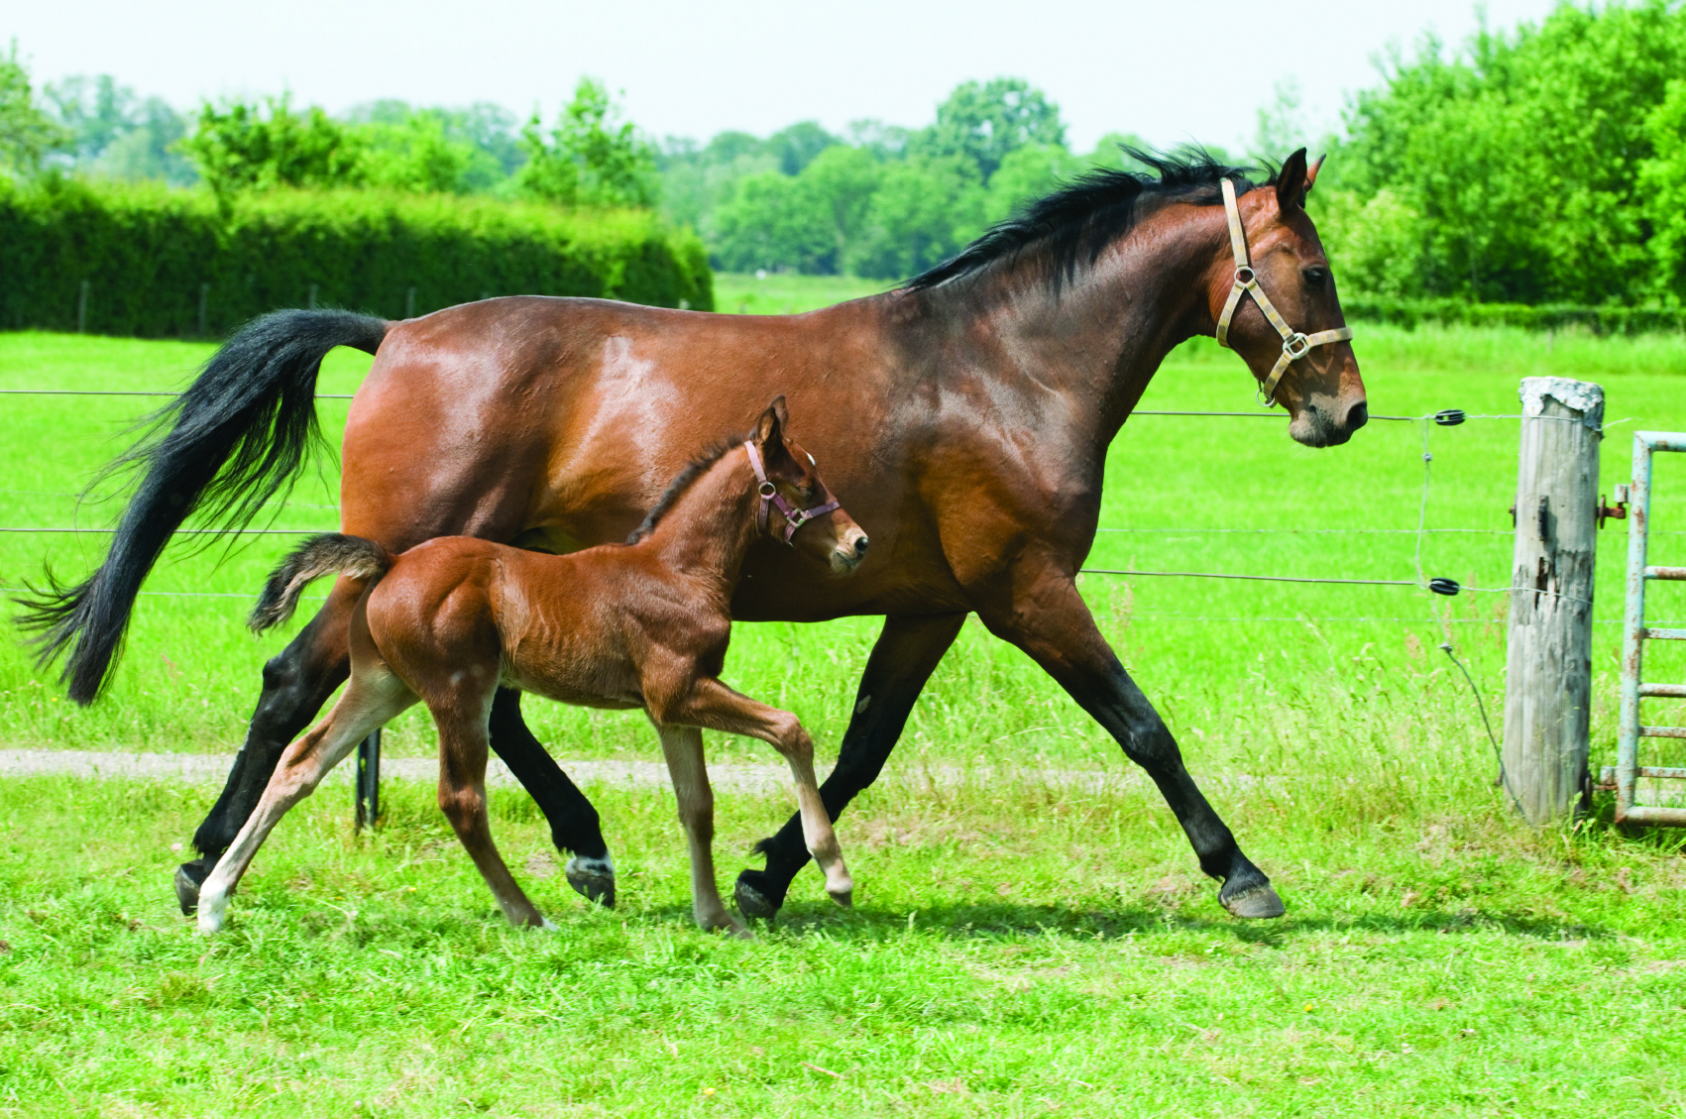
PROTEIN
HN
Proteins are naturally occurring combinations of amino acids that are essential constituents of all living cells
  Body Builders
    Tissue & Cell Formation
    Bone and Muscle Development
  Proteins are needed for:
    *Reproduction Finishing
    *Lactation Maintenance
    *Growth Work

Slide 7
PROTEIN LEVELS & SOURCES
HN
LEVELS
Level of protein determined by
  Age
  Activity level
  Quality of forage and type
Moderate-Heavy Work
Supplementation with 12 to14% protein feed
Mares and Foals
  Require higher protein levels – 14-16% protein
Maintenance
  Generally, requires about 10% protein supplementation
SOURCES
Soybean meal
Milk protein

Slide 8
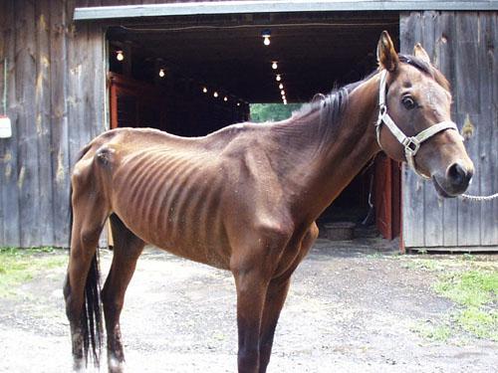
PROTEIN DEFICIENCIES
HN
Depressed Appetite
Poor Growth
Loss of Weight
Reduced Milk Production
Irregular Estrus
Lowered Foal Crops
Loss of Condition
Lack of Stamina

Slide 9

ENERGY
HN
Energy is the most limiting and crucial. It is needed in the largest amount of all the essential nutrients.
Expressed As:
  Calories
  TDN

Slide 10
ENERGY
HN
The first and foremost function of energy is to meet body maintenance needs
  Body Maintenance
    Heart Function Movement
    Lung Function Excretion of Waste
    Tissue Function Nutrient Intake
    Muscle Function

Slide 11
ENERGY SOURCES
HN
Carbohydrates
Sugars
Starches
Cellulose
Fats and Oils
Animal
Vegetable
Oats

Slide 12

BENEFITS OF ADDED FAT
HN
Increase calorie content of the diet
Increase fat content of mare’s milk
Improve stamina
  Fat is utilized during short duration work sparing glycogen stores in the muscle

Slide 13

MINERALS
HN
Increase inorganic elements that are essential for overall health
Just as important as the other essential nutrient requirements, needed in smaller amounts

Slide 14
MINERAL CLASSIFICATIONS
HN
Macro Minerals
Calcium (Ca)
Chlorine (Cl)
Magnesium (Mg)
Phosphorus (P)
Potassium (K)
Sodium (Na)
Sulfur (S)
Trace or Micro Minerals
Chromium (Cr)
Cobalt (Co)
Copper (Cu)
Fluorine (F0
Iodine (I)
Iron (Fe)
Manganese (Mn)
Molybdenum (Mo)
Selenium (Se)
Silicon (Si)
Zinc (Zn)

Slide 15

MINERAL SOURCES
HN
Oxides
  10% Bio Available
Sulfates
  50% Bio Available
Chelates
  95% Bio Available

Slide 16
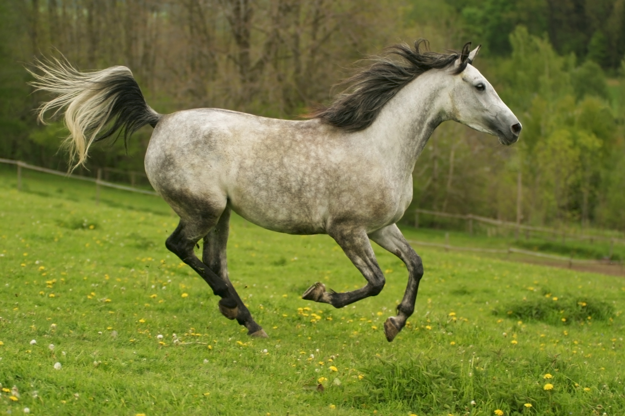
MINERAL FUNCTIONS
HN
Skeleton & Muscle Formation
Blood Formation & Coagulation
Nerve Tissue Reaction
pH Regulation
Enzyme Systems
Protein Synthesis
Energy Metabolism
Reproduction & Lactation
Nutrient Assimilation

Slide 17
MINERAL DEFICIENCIES
HN
Decreased Appetite
Poor Feed Conversion
Poor Conception
Slower Breed Back
Decreased Milk Production
Poor Bone & Muscle Development
Stress Diseases
Reduced Growth & Weight Gain

Slide 18
CALCIUM TO PHOSPHORUS RATIO
HN
1:1 to 1.5:1 Recommended
2:1 Acceptable
  Legume hay
Balance
Sel-Plex

Slide 19

VITAMINS
HN
Complex organic compounds required in minute amounts for normal growth, reproduction and health
Used For
  Normal Growth
  Production
  Reproduction
  Overall Health

Slide 20

VITAMINS
HN
Two types of Vitamins
  Water Soluble
    Flushed out of the System Daily
    Needed Daily from the Diet
  Fat Soluble
    Supplied by the Feed
    Stored in the Liver for a few Days
    Deficiencies are Greater than Water Soluble

Slide 21
VITAMINS
HN
Fat Soluble
A
D
E
K
Water Soluble
B12
Biotin
C
Choline
Folic Acid
Inositol
Niacin
Pantothenic Acid
Pyridoxine (B6)
Riboflavin (B2)
Thiamine (B1)

Slide 22
WATER
HN
One of the most vital of all nutrients
Live longer without feed than water
Can be provided in abundance
Some Benefits
Lubrication
  Digestion
  Waste Removal
  Temperature Regulation in Body

Slide 23

HN
HORSE FEEDS

Slide 24

1022 SWEET TREAT
HN
An all-purpose, economical sweet feed
INGREDIENTS
Grain products, plant protein products, processed grain by-products, roughage products (25%), cane molasses, calcium carbonate, dicalcium phosphate, salt.
FEEDING DIRECTIONS
HORSES: Feed 1 to 11/2 lb per 100 lb of body weight per head per day with adequate good quality hay or grazing. Do not feed free choice. Do not exceed the recommended feeding rate. Provide a source of fresh, clean water at all times.
CATTLE: Feed 1 to 2 lb per 100 lb of body weight per head per day with adequate good quality hay or grazing. Provide a source of fresh, clean water at all times.
GUARANTEED ANALYSIS
Crude Protein, minimum 10.00%
Crude Fat, minimum 2.50%
Crude Fiber, maximum 16.00%
Calcium (Ca), minimum 1.00%
Calcium (Ca), maximum 1.50%
Phosphorus (P), minimum 0.50%
Salt (NaCl), minimum 0.50%
Salt (NaCl), maximum 1.00%
Potassium (K), minimum 0.50%
Copper (Cu), minimum 10 ppm
Selenium (Se), minimum 0.10 ppm
Zinc (Zn), minimum 15 ppm
FEATURES
10% protein
Mixture of corn, oats and pellets
BENEFITS
Diverse - can be fed to horses and cattle.
Molasses improves palatability and eliminates dust.

Slide 25

1024 12% SWEET TREAT
HN
An economical sweet feed for horses and cattle
INGREDIENTS
Crimped whole oats, chopped yellow corn, cane molasses, soybean meal, wheat middlings, rice bran, corn oil, soy lecithin, calcium carbonate, dicalcium phosphate, salt, vitamin A supplement, vitamin D3 supplement, vitamin E supplement, vitamin B12 supplement, riboflavin supplement, niacin supplement, calcium pantothenate, choline chloride, folic acid, thiamine mononitrate, pyridoxine hydrochloride, biotin, sodium selenite, zinc sulfate, ferrous sulfate, manganese sulfate, copper sulfate, ethylenediamine dihydroiodide.
FEEDING DIRECTIONS
The recommended feeding rate is shown in the chart on the bag. Do not feed free choice. If you feed by dry measure, periodically weigh the feed to ensure that the proper amount is being fed. Observe the condition of your horse over a period of time. The recommended feeding rates may be increased or decreased by 10% to keep your horse in the desired condition. Changes in feed or feeding rate should be made gradually over several days. Feed at regular times at least twice daily. If horse is hot, excited, or ill, delay feeding. Do not allow horse to over-consume or eat rapidly.
GUARANTEED ANALYSIS
Crude Protein, minimum 12.00%
Crude Fat, minimum 2.50%
Crude Fiber, maximum 15.00%
Calcium (Ca), minimum 1.00%
Calcium (Ca), maximum 1.50%
Phosphorus (P), minimum 0.50%
Salt (NaCl), minimum 0.50%
Salt (NaCl), maximum 1.00%
Potassium (K), minimum 0.75%
Copper (Cu), minimum 10 ppm
Selenium (Se), minimum 0.10 ppm
Zinc (Zn), minimum 15 ppm
FEATURES
12% protein
Mixture of corn, oats, pellets and molasses
BENEFITS
Diverse - can be fed to horses and cattle.
Molasses improves palatability and eliminates dust.

Slide 26

1018 HEAVY DUTY “14”
HN
A vitamin fortified, balanced sweet feed for working horses, mares, and foals.
INGREDIENTS
Crimped whole oats, chopped yellow corn, cane molasses, soybean meal, wheat middlings, rice bran, corn oil, soy lecithin, calcium carbonate, dicalcium phosphate, salt, vitamin A supplement, vitamin D3 supplement, vitamin E supplement, vitamin B12 supplement, riboflavin supplement, niacin supplement, calcium pantothenate, choline chloride, folic acid, thiamine mononitrate, pyridoxine hydrochloride, biotin, sodium selenite, zinc sulfate, ferrous sulfate, manganese sulfate, copper sulfate, ethylenediamine dihydroiodide .
FEEDING DIRECTIONS
The recommended feeding rate is shown in the chart on the bag. Do not feed free choice. If you feed by dry measure, periodically weigh the feed to ensure that the proper amount is being fed. Observe the condition of your horse over a period of time. The recommended feeding rates may be increased or decreased by 10% to keep your horse in the desired condition. Changes in feed or feeding rate should be made gradually over several days. Feed at regular times at least twice daily. If horse is hot, excited, or ill, delay feeding. Do not allow horse to over-consume or eat rapidly
GUARANTEED ANALYSIS
Crude Protein, minimum 14.00%
Crude Fat, minimum 5.00%
Crude Fiber, maximum 7.50%
Calcium (Ca), minimum 0.40%
Calcium (Ca), maximum 0.80%
Phosphorus (P), minimum 0.40%
Copper (Cu), minimum 10 ppm
Selenium (Se), minimum 0.10 ppm
Zinc (Zn), minimum 50 ppm
Vitamin A, minimum 3,000 IU/lb
Vitamin D3, minimum 375 IU/lb
Vitamin E, minimum 36 IU/lb
FEATURES
High energy – 1665 Kcal/lb
14% protein
5% fat
Fortified with vitamins A & E
BENEFITS
Horses remain in top condition and health.
Recommended for studs during the breeding season.
Molasses improves palatability and eliminates dust.
Horses cannot sort ration.

Slide 27

1028 HEAVY DUTY HORSE & CATTLE
HN
The original all grain sweet feed developed by the founder of our company nearly ninety years ago. It has remained as the standard of quality throughout Texas and Louisiana.
INGREDIENTS
Whole oats, chopped yellow corn, cane molasses, soybean meal, calcium carbonate, dicalcium phosphate, salt.
FEEDING DIRECTIONS
The recommended feeding rate is shown in the chart below. Do not feed free choice. If you feed by dry measure, periodically weigh the feed to ensure that the proper amount is being fed. Observe the condition of your horse over a period of time. The recommended feeding rates may be increased or decreased by 10% to keep your horse in the desired condition. Changes in feed or feeding rate should be made gradually over several days. Feed at regular times at least twice daily. If horse is hot, excited, or ill, delay feeding. Do not allow horse to over-consume or eat rapidly.
Light Work: Feed 1/2 pound of Lone Star® Heavy Duty Horse and Cattle Feed and a minimum of one pound of good quality hay per 100 pounds of body weight per horse per day.
Medium Work: Feed 3/4 pound of Lone Star® Heavy Duty Horse and Cattle Feed and a minimum of one pound of good quality hay per 100 pounds of body weight per horse per day.
Heavy Work: Feed one pound of Lone Star® Heavy Duty Horse and Cattle Feed and a minimum of one pound of good quality hay per 100 pounds of
GUARANTEED ANALYSIS
Crude Protein, minimum 10.00%
Crude Fat, minimum 3.00%
Crude Fiber, maximum 7.50%
Calcium (Ca), minimum 0.50%
Calcium (Ca), maximum 1.00%
Phosphorus (P), minimum 0.40%
Salt (NaCl), minimum 0.25%
Salt (NaCl), maximum 0.75%
Potassium (K), minimum 0.40%
Copper (Cu), minimum 10 ppm
Selenium (Se), minimum 0.10 ppm
Zinc (Zn), minimum 20 ppm
FEATURES
High energy – 1642 Kcal/lb
10% protein
Mixture of quality corn, oats and molasses
BENEFITS
Diverse-formulated for horses and cattle.
Molasses improves palatability and eliminates dust.
Economical-only one feed is needed for both horses and cattle

Slide 28
1029 HEAVY DUTY “12” HORSE FEED
HN
A vitamin fortified sweet feed formulated for the maintenance of active pleasure horses.
INGREDIENTS
Whole oats, chopped yellow corn, cane molasses, soybean meal, calcium carbonate, dicalcium phosphate, salt, vitamin A supplement, vitamin D3 supplement, vitamin E supplement, vitamin B12 supplement, riboflavin supplement, niacin supplement, calcium pantothenate, choline chloride, folic acid, calcium pantothenate, choline chloride, folic acid, thiamine mononitrate, pyridoxine hydrochloride, biotin, sodium selenite, zinc sulfate, ferrous sulfate, manganese sulfate, copper sulfate, ethylenediamine dihydroiodide.
FEEDING DIRECTIONS
HORSES: The recommended feeding rate is shown in the chart below. Observe your horse over a period of time. The recommended feeding rates may be increased or decreased by 10% to keep your horse in the desired condition. Do not exceed more than 10% above the recommended rate. Do not feed free choice.
Wt. of Horse 600 800 1000 1200 1400
HAY/PASTURE (min. lb/day) 6 8 10 12 14
HEAVY DUTY “12” HORSE FEED
Maintenance Only (lb/day) 4 5 6 7 8
Light Work 5 7 9 11 12
Moderate Work 7 9 12 14 16
Changes in feed or feeding rate should be made gradually over several days. Changes in feeding rate should not exceed 1 pound per head per day. Feed at regular times at least twice daily. If horse is hot, excited, or ill, delay feeding. Do not allow horse to over-consume or eat rapidly. An effective parasite control program is essential to your horse’s health. Observe your horse’s condition regularly. Consult your veterinarian if any problems arise.
GUARANTEED ANALYSIS
Crude Protein, minimum 12.00%
Crude Fat, minimum 3.50%
Crude Fiber, maximum 7.50%
Calcium (Ca), minimum 0.90%
Calcium (Ca), maximum 1.20%
Phosphorus (P), minimum 0.40%
Copper (Cu), minimum 20 ppm
Selenium (Se), minimum 0.20 ppm
Zinc (Zn), minimum 50 ppm
Vitamin A, minimum 3,000 IU/lb
Vitamin D3, minimum 375 IU/lb
Vitamin E, minimum 36 IU/lb
FEATURES
1617 Kcal/lb
12% protein
Oats and corn-based ration
Vitamin and mineral fortified
BENEFITS
Molasses improves palatability.
Maintains good body condition

Slide 29

1092 TRACK STAR 2
HN
Our state-of-the-art, vitamin fortified, balanced sweet feed for active performance and breeding horses.
INGREDIENTS
Crimped oats, chopped yellow corn, cane molasses, soybean meal, wheat middlings, rice bran, soybean oil, soy lecithin, calcium carbonate, dicalcium phosphate, yeast culture, salt, dried Lactobacillus acidophilus fermentation product, dried Streptococcus faecium fermentation product, dried Aspergillus oryzae fermentation extract, dried Aspergillus niger fermentation extract, vitamin A supplement, vitamin D3 supplement, vitamin E supplement, vitamin B12 supplement, riboflavin supplement, niacin supplement, calcium pantothenate, choline chloride, folic acid, thiamine mononitrate, pyridoxine hydrochloride, biotin, selenium yeast, zinc methionine complex, zinc sulfate, iron amino acid chelate, ferrous sulfate, manganese amino acid chelate, manganese sulfate, copper amino acid chelate, copper sulfate, ethylenediamine dihydroiodide.
FEEDING DIRECTIONS
The recommended feeding rate for TRACK STAR® 2 is shown in the chart on the bag. Do not feed free choice. If you feed by dry measure, periodically weigh the feed to ensure that the proper amount is being fed. Observe the condition of your horse over a period of time. The recommended feeding rates may be increased or decreased by 10% to keep your horse in the desired condition. Do not exceed 10% above the recommended rate.
Changes in feed or feeding rate should be made gradually over several days. Changes in feeding rate should not exceed 1 pound per day. Feed at regular times at least twice daily. If horse is hot, excited, or ill, delay feeding. Do not allow horse to over-consume or eat rapidly.
An effective internal parasite control program is essential to your horse’s health. Observe your horse’s condition regularly. Consult your veterinarian if any problems arise.
GUARANTEED ANALYSIS
Crude Protein, minimum 14.00%
Crude Fat, minimum 7.00%
Crude Fiber, maximum 7.00%
Calcium (Ca), minimum 0.60%
Calcium (Ca), maximum 1.00%
Phosphorus (P), minimum 0.50%
Copper (Cu), minimum 55 ppm
Selenium (Se), minimum 0.60 ppm
Zinc (Zn), minimum 220 ppm
Vitamin A, minimum 5,000 IU/lb
Vitamin D3, minimum 500 IU/lb
Vitamin E, minimum 36 IU/lb
FEATURES
High energy-1677 Kcal/lb Added fat
14% protein Chelated trace minerals
Extra vitamins & minerals Fortified with probiotics
Organic selenium Pellets for added protein
BENEFITS
Horses remain in top condition.
Horses can’t sort ration -- full feed is consumed.
Excellent ration for stallions and brood mares.
Added fat increases caloric density.
Chelated trace minerals improve availability.
Beneficial microbes, yeast culture, and enzymes contained in the probiotics improve digestion, performance, and overall health.
Organic selenium is more easily absorbed and retained for improved health and performance.

Slide 30
1093 TRACK STAR 3
HN
Our state-of-the-art, vitamin fortified, balanced sweet feed formulated especially for brood mares and foals.
INGREDIENTS
Crimped oats, chopped yellow corn, cane molasses, soybean meal, wheat middlings, rice bran, soybean oil, soy lecithin, calcium carbonate, dicalcium phosphate, yeast culture, salt, dried Lactobacillus acidophilus fermentation product, dried Streptococcus faecium fermentation product, dried Aspergillus oryzae fermentation extract, dried Aspergillus niger fermentation extract, vitamin A supplement, vitamin D3 supplement, vitamin E supplement, vitamin B12 supplement, riboflavin supplement, niacin supplement, calcium pantothenate, choline chloride, folic acid, thiamine mononitrate, pyridoxine hydrochloride, biotin, selenium yeast, zinc methionine complex, zinc sulfate, iron amino acid chelate, ferrous sulfate, manganese amino acid chelate, manganese sulfate, copper amino acid chelate, copper sulfate, ethylenediamine dihydroiodide.
FEEDING DIRECTIONS
The recommended feeding rate for TRACK STAR® 3 is shown in the chart on the bag. Do not feed free choice. If you feed by dry measure, periodically weigh the feed to ensure that the proper amount is being fed. Observe the condition of your horse over a period of time. The recommended feeding rates may be increased or decreased by 10% to keep your horse in the desired condition. Do not exceed 10% above the recommended rate.
Changes in feed or feeding rate should be made gradually over several days. Changes in feeding rate should not exceed 1 pound per day. Feed at regular times at least twice daily. If horse is hot, excited, or ill, delay feeding. Do not allow horse to over-consume or eat rapidly.
An effective internal parasite control program is essential to your horse’s health. Observe your horse’s condition regularly. Consult your veterinarian if any problems arise.
GUARANTEED ANALYSIS
Crude Protein, minimum 16.00%
Crude Fat, minimum 7.00%
Crude Fiber, maximum 7.00%
Calcium (Ca), minimum 0.60%
Calcium (Ca), maximum 1.00%
Phosphorus (P), minimum 0.60%
Copper (Cu), minimum 55 ppm
Selenium (Se), minimum 0.60 ppm
Zinc (Zn), minimum 220 ppm
Vitamin A, minimum 5,000 IU/lb
Vitamin D3, minimum 500 IU/lb
Vitamin E, minimum 36 IU/lb
FEATURES
High energy-1669 Kcal/lb Added fat
16% protein Chelated trace minerals
Extra vitamins & minerals Fortified with probiotics
Pellets for added protein Organic selenium
BENEFITS
Mares remain in top condition while nursing foals.
Extra vitamins and minerals for brood mares and foals.
Low fiber benefits mares in late gestation.
Excellent feed for breeding stallions.
Added fat increased caloric density.
Chelated trace minerals improve availability.
Beneficial microbes, yeast culture, and enzymes contained in the probiotics improve digestion, performance, and overall health.
Organic selenium is more easily absorbed and retained for improved health and performance.

Slide 31
1021 TRACK STAR WITH BEET PULP
HN
A high energy sweet feed containing shredded beet pulp formulated for speed and endurance in performance horses while minimizing the occurrence of digestive upset.
INGREDIENTS
Crimped oats, shredded beet pulp (15%), chopped yellow corn, cane molasses, soybean meal, wheat middlings, rice bran, corn oil, soy lecithin, calcium carbonate, dicalcium phosphate, salt, vitamin A supplement, vitamin D3 supplement, vitamin E supplement, vitamin B12 supplement, riboflavin supplement, niacin supplement, calcium pantothenate, choline chloride, folic acid, thiamine mononitrate, pyridoxine hydrochloride, biotin, selenium yeast, zinc methionine complex, zinc sulfate, iron amino acid chelate, ferrous sulfate, manganese amino acid chelate, manganese sulfate, copper amino acid chelate, copper sulfate, ethylenediamine dihydroiodide.
FEEDING DIRECTIONS
The recommended feeding rate for TRACK STAR® WITH BEET PULP is shown in the chart on the bag. Do not feed free choice. If you feed by dry measure, periodically weigh the feed to ensure that the proper amount is being fed. Observe the condition of your horse over a period of time. The recommended feeding rates may be increased or decreased by 10% to keep your horse in the desired condition. Do not exceed 10% above the recommended rate.
Changes in feed or feeding rate should be made gradually over several days. Changes in feeding rate should not exceed 1 pound per day. Feed at regular times at least twice daily. If horse is hot, excited, or ill, delay feeding. Do not allow horse to over-consume or eat rapidly.
An effective internal parasite control program is essential to your horse’s health. Observe your horse’s condition regularly. Consult your veterinarian if any problems arise.
GUARANTEED ANALYSIS
Crude Protein, minimum 12.00%
Crude Fat, minimum 8.00%
Crude Fiber, maximum 12.00%
Calcium (Ca), minimum 0.90%
Calcium (Ca), maximum 1.20%
Phosphorus (P), minimum 0.50%
Copper (Cu), minimum 55 ppm
Selenium (Se), minimum 0.60 ppm
Zinc (Zn), minimum 220 ppm
Vitamin A, minimum 5,000 IU/lb
Vitamin D3, minimum 500 IU/lb
Vitamin E, minimum 36 IU/lb
FEATURES
1576 Kcal/lb Organic selenium
12% protein 15% shredded beet pulp
Added vegetable oil Vitamin fortified
Chelated trace minerals
BENEFITS
High caloric content with added fiber improves overall performance with reduced risk of digestive upset.
Added oil maintains blood glucose levels for performance and endurance.
Reduced lactic acid and accumulation in the muscles for improved recovery time after exercise.
Chelated trace minerals and organic selenium are more easily absorbed and retained for improved health.
Fortified with vitamin E to maintain muscle health and performance in working horses.
Molasses and vegetable oil maximizes palatability.

Slide 32
HN

Slide 33
CONTROLLED NON-STRUCTURAL CARBOHYDRATES (NSC)
HN
Non-Structural Carbohydrate (NSC) is the term to describe the sugar and starch content of the feed.
Grains are high in NSC
Fiber is low in NSC
In recent years, it has been recognized that horses are not designed to digest high levels of sugar and starch.

Slide 34
CONTROLLING NSC
HN
Excess starch can cause metabolic disturbances leading to problems such as colic, laminitis (founder), and obesity
Controlling starch ensures proper digestion throughout the intestinal tract, providing adequate energy without excess starch moving into the hindgut.
If too much starch is consumed in one meal, undigested portions can pass to the hindgut where they ferment, contributing to gas colic and metabolic problems.
If too little starch and sugar is consumed in the total diet, an equine athlete may not recover as rapidly after exercise.

Slide 35
NSC VALUES IN FEED INGREDIENTS
HN
CORN – 67.2%
OATS – 38.8%
SOYBEAN MEAL – 13.8%
SOYBEAN HULLS – 2.4%
ALFALFA – 5.6%
WHEAT MIDDLINGS – 24.3%
RICE BRAN – 26.9%
MOLASSES – 33%
FLAXSEED – 6.3%
SHREDDED BEET PULP – 19.3%

Slide 36
CHELATED MINERALS
HN
CHELATED MINERAL – Uses organic compounds like amino acids to improve nutrient absorption and utilization.
Copper - Lysine
Iron - Methionine
Manganese - Methionine
Zinc - Methionine
AVAILABILITY
OXIDES – Least digestible
SULFATES – More digestible
CHELATES – Highly digestible
A blend of chelates and sulfates is desirable to optimize nutrient availability.

Slide 37
SEL-PLEX
HN
Organic form of selenium derived from yeast
Readily absorbed, stored, and utilized by the animal.
Antioxidant properties to support immune system
Important nutrient for reproduction due to its interaction with vitamin E
Most researched and proven form of organic selenium
Listed on the tag as selenium yeast
Inorganic forms of selenium are sodium selenite and sodium selenate
Soils are typically deficient in selenium resulting in selenium deficient forages
Selenium requirement of horses is estimated at 1 ppm

Slide 38
PROBIOTICS
HN
THREE SPECIFIC STRAINS
Lactobacillus acidophilus
Enterococcus faecium
Aspergillus oryzae
BENEFITS
Maintains a high population of good bacteria – Promotes good health
Improves digestion
Improved overall performance

Slide 39
OTHER FEATURES
HN
YEA-SACC
Yeast culture used as the carrier for the probiotics
Contains enzymes to enhance digestion
Protease – Protein digestion
Amylase – Carbohydrate digestion
Cellulase – Fiber digestion
OMEGA FATTY ACIDS
Improved joint health – Reduces inflammation
Improved airway function
Improved reproductive health
Improved immune function
Boost in vaccine response
Role in brain development – Facilitates trainability
Improved hoof and coat condition

Slide 40
OTHER FEATURES
HN
ADDED FAT
By replacing grains with fat, energy can be added to the diet while lowering the NSC value of the diet.
Improved stamina
Prevents overheating during the summer months
Calming effect
Improved absorption of fat soluble vitamins A, D, and E
Helps to maintain blood glucose levels for performance and endurance
BEET PULP
A fermentable source of fiber in the hindgut supplying energy and prebiotics, which are beneficial to intestinal microbes
Volatile fatty acids are produced during the fermentation process which are utilized as energy
Volatile fatty acids provide a nutrient source for the prebiotics

Slide 41

1101 INFINITY COMPLETE OS
HN
This optimal starch formula provides a 14.5% level of controlled nonstructural carbohydrates (NSC). Controlling the level of NSC has been shown to be beneficial in reducing the incidence of carbohydrate induced metabolic disorders.
INGREDIENTS
Dehydrated alfalfa meal, wheat middlings, rice bran, magnesium mica, soybean oil, cane molasses, shredded beet pulp, calcium carbonate, dicalcium phosphate, flaxseed, fish oil, salt, yeast culture, dried Lactobacillus acidophilus fermentation product, dried Enterococcus faecium fermentation product, dried Aspergillus oryzae fermentation extract, vitamin A supplement, vitamin D3 supplement, vitamin E supplement, vitamin B12 supplement, riboflavin supplement, thiamine mononitrate, folic acid, biotin, L-lysine, manganese amino acid chelate, manganese sulfate, iron amino acid chelate, ferrous sulfate, copper amino acid chelate, copper sulfate, zinc sulfate, zinc methionine complex, niacin supplement, calcium pantothenate, choline chloride, ethylenediamine dihydroiodide, selenium yeast, pyridoxine hydrochloride.
FEEDING DIRECTIONS
The recommended feeding rate for INFINITY COMPLETE OS is shown in the chart on the bag. Do not feed free choice. If you feed by dry measure, periodically weigh the feed to ensure that the proper amount is being fed. Observe the condition of your horse over a period of time. The recommended feeding rates may be increased or decreased by 10% to keep your horse in the desired condition. Do not exceed 10% above the recommended rate.
Changes in feed or feeding rate should be made gradually over several days. Changes in feeding rate should not exceed 1 pound per day. Feed at regular times at least twice daily. If horse is hot, excited, or ill, delay feeding. Do not allow horse to over-consume or eat rapidly.
An effective internal parasite control program is essential to your horse’s health. Observe your horse’s condition regularly. Consult your veterinarian if any problems arise.
GUARANTEED ANALYSIS
Crude Protein, minimum 14.00%
Lysine, minimum 0.80%
Crude Fat, minimum 8.00%
Crude Fiber, maximum 16.00%
Dietary Starch, maximum 14.50%
Calcium (Ca), minimum 0.90%
Calcium (Ca), maximum 1.20%
Phosphorus (P), minimum 0.75%
Copper (Cu), minimum 50 ppm
Selenium (Se), minimum 0.60 ppm
Zinc (Zn), minimum 160 ppm
Vitamin A, minimum 3,500 IU/lb
Vitamin D3, minimum 350 IU/lb
Vitamin E, minimum 100 IU/lb
FEATURES
14% protein Probiotics
8% fat Alfalfa-based formula 14.5% NSC Beet pulp
Chelated sources of copper, zinc, iron and manganese
BENEFITS
Quality sources of fiber along with low NSC helps to reduce chances of digestive upset.
Chelated trace minerals and organic selenium are more easily absorbed and retained.
Added fat help to maintain blood glucose levels for performance and endurance.
Probiotics replenish beneficial micro-oganisms in the digestive tract.
Beet pulp – a fermentable source of fiber in the hindgut supplying energy and prebiotics, which are beneficial to intestinal microbes.
Flaxseed and fish oil provide beneficial omega-3 fatty acids to support immune function and reduce inflammation.

Slide 42
1102 INFINITY PRIME PERFORMANCE EN
HN
Exceptional nutrition for performance and breeding horses. The high caloric density delivers more nutrition per pound with an excellent source of fiber for a healthy digestive tract.
INGREDIENTS
Wheat middlings, rice bran, dehydrated alfalfa meal, magnesium mica, soybean oil, cane molasses, calcium carbonate, soybean meal, ground yellow corn, shredded beet pulp, salt, flaxseed, fish oil, yeast culture, dried Lactobacillus acidophilus fermentation product, dried Enterococcus faecium fermentation product, dried Aspergillus oryzae fermentation extract, vitamin A supplement, vitamin D3 supplement, vitamin E supplement, vitamin B12 supplement, riboflavin supplement, niacin supplement, calcium pantothenate, choline chloride, folic acid, thiamine mononitrate, pyridoxine hydrochloride, biotin, copper amino acid chelate, copper sulfate, ethylenediamine dihydroiodide, iron amino acid chelate, ferrous sulfate, manganese amino acid chelate, manganese sulfate, selenium yeast, zinc methionine complex, zinc sulfate.
FEEDING DIRECTIONS
The recommended feeding rate for INFINITY PRIME PERFORMANCE EN is shown in the chart on the bag. Do not feed free choice. If you feed by dry measure, periodically weigh the feed to ensure that the proper amount is being fed. Observe the condition of your horse over a period of time. The recommended feeding rates may be increased or decreased by 10% to keep your horse in the desired condition. Do not exceed 10% above the recommended rate.
Changes in feed or feeding rate should be made gradually over several days. Changes in feeding rate should not exceed 1 pound per day. Feed at regular times at least twice daily. If horse is hot, excited, or ill, delay feeding. Do not allow horse to over-consume or eat rapidly.
An effective internal parasite control program is essential to your horse’s health. Observe your horse’s condition regularly. Consult your veterinarian if any problems arise.
GUARANTEED ANALYSIS
Crude Protein, minimum 14.00%
Crude Fat, minimum 8.00%
Crude Fiber, maximum 12.00%
Dietary Starch, maximum 20.00%
Calcium (Ca), minimum 0.60%
Calcium (Ca), maximum 1.00%
Phosphorus (P), minimum 0.60%
Copper (Cu), minimum 55 ppm
Selenium (Se), minimum 0.30 ppm
Zinc (Zn), minimum 220 ppm
Vitamin A, minimum 3,000 IU/lb
Vitamin D3, minimum 375 IU/lb
Vitamin E, minimum 50 IU/lb
FEATURES Flaxseed and fish oil
14% protein Probiotics
1401 Kcal/lb Chelated sources of copper,
8% fat zinc, iron and manganese
Soybean oil Beet pulp
BENEFITS
High caloric density for energy.
Soybean oil promotes healthy skin and hair coat.
Chelated trace minerals and organic selenium are more easily absorbed and retained.
Chelated zinc from Zinpro promotes hoof health.
Added fat help to maintain blood glucose levels for performance and endurance.
Probiotics replenish beneficial micro-organisms.
Beet pulp – a fermentable source of fiber in the hindgut supplying energy and prebiotics, which are beneficial to intestinal microbes.
Flaxseed and fish oil provide beneficial omega-3 fatty acids to support immune function and reduce inflammation.

Slide 43
1103 INFINITY ALFA-PRO FS
HN
Provides focused support for maintenance of mature horse with built in forage from high quality alfalfa meal.
INGREDIENTS
Roughage products (36%), rice bran, wheat middlings, dehydrated alfalfa meal, ground yellow corn, soybean meal, cane molasses, calcium carbonate, magnesium mica, salt, flaxseed, fish oil, yeast culture, dried Lactobacillus acidophilus fermentation product, dried Enterococcus faecium fermentation product, dried Aspergillus oryzae fermentation extract, vitamin A supplement, vitamin D3 supplement, vitamin E supplement, vitamin B12 supplement, riboflavin supplement, niacin supplement, calcium pantothenate, choline chloride, folic acid, thiamine mononitrate, pyridoxine hydrochloride, biotin, copper amino acid chelate, copper sulfate, ethylenediamine dihydroiodide, iron amino acid chelate, ferrous sulfate, manganese amino acid chelate, manganese sulfate, selenium yeast, zinc methionine complex, zinc sulfate
FEEDING DIRECTIONS
The recommended feeding rate for INFINITY ALFA-PRO FS is shown in the chart on the bag. Do not feed free choice. If you feed by dry measure, periodically weigh the feed to ensure that the proper amount is being fed. Observe the condition of your horse over a period of time. The recommended feeding rates may be increased or decreased by 10% to keep your horse in the desired condition. Do not exceed 10% above the recommended rate.
Changes in feed or feeding rate should be made gradually over several days. Changes in feeding rate should not exceed 1 pound per day. Feed at regular times at least twice daily. If horse is hot, excited, or ill, delay feeding. Do not allow horse to over-consume or eat rapidly.
An effective internal parasite control program is essential to your horse’s health. Observe your horse’s condition regularly. Consult your veterinarian if any problems arise.
GUARANTEED ANALYSIS
Crude Protein, minimum 12.00%
Crude Fat, minimum 5.00%
Crude Fiber, maximum 20.00%
Dietary Starch, maximum 20.00%
Calcium (Ca), minimum 0.50%
Calcium (Ca), maximum 1.00%
Phosphorus (P), minimum 0.45%
Copper (Cu), minimum 20 ppm
Selenium (Se), minimum 0.30 ppm
Zinc (Zn), minimum 50 ppm
Vitamin A, minimum 3,000 IU/lb
Vitamin D3, minimum 375 IU/lb
Vitamin E, minimum 50 IU/lb
FEATURES Flaxseed and fish oil
12% protein Probiotics
20% fiber Vitamin fortified 5% fat Beet pulp
Chelated sources of copper, zinc, iron & manganese
BENEFITS
Labor savings and convenient – no need to store and feed large amounts of hay.
Provides a good source of roughage.
Minimal waste – pellets ensure that full ration is consumed.
Chelated trace minerals and organic selenium are more easily absorbed and retained.
Chelated zinc from Zinpro promotes hoof health.
Probiotics replenish beneficial micro-organisms.
Beet pulp – a fermentable source of fiber in the hindgut supplying energy and prebiotics, which are beneficial to intestinal microbes.
Flaxseed and fish oil provide beneficial omega-3 fatty acids to support immune function and reduce inflammation.

Slide 44
SENIOR HORSES
HN
Age
Digestive System
  Carbohydrates
  Fat
  Fiber
  Vitamins
  Beet Pulp

Slide 45
1104 SENIOR CN
HN
A highly fortified ration that provides continued support for the special needs of senior horses.
INGREDIENTS
Wheat middlings, dehydrated alfalfa meal, rice bran, soybean hulls, cane molasses, soybean oil, rice hulls, shredded beet pulp, calcium carbonate, salt, flaxseed, fish oil, yeast culture, dried Lactobacillus acidophilus fermentation product, dried Enterococcus faecium fermentation product, dried Aspergillus oryzae fermentation extract, vitamin A supplement, vitamin D3 supplement, vitamin E supplement, vitamin B12 supplement, riboflavin supplement, thiamine mononitrate, folic acid, biotin, L-ascorbyl-2-polyphosphate (source of vitamin C), manganese amino acid chelate, manganese sulfate, iron amino acid chelate, ferrous sulfate, copper amino acid chelate, copper sulfate, zinc sulfate, zinc methionine complex, niacin supplement, calcium pantothenate, choline chloride, ethylenediamine dihydroiodide, selenium yeast, pyridoxine hydrochloride.
FEEDING DIRECTIONS
The recommended feeding rate for INFINITY SENIOR CN is shown in the chart on the bag. Do not feed free choice. If you feed by dry measure, periodically weigh the feed to ensure that the proper amount is being fed. Observe the condition of your horse over a period of time. The recommended feeding rates may be increased or decreased by 10% to keep your horse in the desired condition. Do not exceed 10% above the recommended rate.
Changes in feed or feeding rate should be made gradually over several days. Changes in feeding rate should not exceed 1 pound per day. Feed at regular times at least twice daily. If horse is hot, excited, or ill, delay feeding. Do not allow horse to over-consume or eat rapidly.
An effective internal parasite control program is essential to your horse’s health. Observe your horse’s condition regularly. Consult your veterinarian if any problems arise.
GUARANTEED ANALYSIS
Crude Protein, minimum 14.00%
Crude Fat, minimum 8.00%
Crude Fiber, maximum 15.00%
Dietary Starch, maximum 19.00%
Calcium (Ca), minimum 0.75%
Calcium (Ca), maximum 1.10%
Phosphorus (P), minimum 0.70%
Copper (Cu), minimum 40 ppm
Selenium (Se), minimum 0.30 ppm
Zinc (Zn), minimum 120 ppm
Vitamin A, minimum 5,000 IU/lb
Vitamin D3, minimum 500 IU/lb
Vitamin E, minimum 75 IU/lb
FEATURES Flaxseed and fish oil
14% protein Probiotics
8% fat Alfalfa & soybean hulls
Beet pulp Omega-3 fatty acids
Vitamins E & C Organic selenium
Chelated sources of copper, zinc, iron and manganese
BENEFITS
Highly digestible nutrients maintain body condition in senior horses.
Fortified with essential B vitamins which may no longer be synthesized in senior horses.
Organic selenium from Sel-Plex provides antioxidant benefits.
Chelated trace minerals and organic selenium are more easily absorbed and retained.
Chelated zinc from Zinpro promotes hoof health.
Probiotics replenish beneficial micro-organisms.
Beet pulp – a fermentable source of fiber in the hindgut supplying energy and prebiotics, which are beneficial to intestinal microbes.
Flaxseed and fish oil provide beneficial omega-3 fatty acids to support immune function and reduce inflammation.

Slide 46
1094 TRACK STAR SENIOR
HN
A highly fortified sweet feed formulated for the special needs of senior horses.
INGREDIENTS
Processed grain by-products, plant protein products, roughage products (19%), forage products, grain products, cane molasses, corn oil, soybean oil, soy lecithin, dried whey, calcium carbonate, dicalcium phosphate, salt, dried Lactobacillus acidophilus fermentation product, dried Enterococcus faecium fermentation product, dried Aspergillus oryzae fermentation extract, L-lysine, DL-methionine, L-ascorbyl-2-polyphosphate (source of vitamin C), vitamin A supplement, vitamin D3 supplement, vitamin E supplement, vitamin B12 supplement, menadione sodium bisulfite complex (source of vitamin K activity), riboflavin supplement, niacin supplement, calcium pantothenate, choline chloride, folic acid, thiamine mononitrate, pyridoxine hydrochloride, biotin, selenium yeast, zinc methionine complex, zinc sulfate, iron amino acid chelate, ferrous sulfate, iron oxide, manganese amino acid chelate, manganese sulfate, copper amino acid chelate, copper sulfate, ethylenediamine dihydroiodide, calcium iodate, cobalt carbonate.
FEEDING DIRECTIONS
The recommended feeding rate for TRACK STAR® SENIOR is shown in the chart on the bag. Do not feed free choice. If you feed by dry measure, periodically weigh the feed to ensure that the proper amount is being fed. Observe the condition of your horse over a period of time. The recommended feeding rates may be increased or decreased by 10% to keep your horse in the desired condition. Do not exceed 10% above the recommended rate.
Changes in feed or feeding rate should be made gradually over several days. Changes in feeding rate should not exceed 1 pound per day. Feed at regular times at least twice daily. If horse is hot, excited, or ill, delay feeding. Do not allow horse to over-consume or eat rapidly.
An effective internal parasite control program is essential to your horse’s health. Observe your horse’s condition regularly. Consult your veterinarian if any problems arise.
GUARANTEED ANALYSIS
Crude Protein, minimum 14.00%
Crude Fat, minimum 8.00%
Crude Fiber, maximum 15.00%
Dietary Starch, maximum 20.00%
Calcium (Ca), minimum 0.90%
Calcium (Ca), maximum 1.50%
Phosphorus (P), minimum 0.75%
Copper (Cu), minimum 55 ppm
Selenium (Se), minimum 0.30 ppm
Zinc (Zn), minimum 220 ppm
Vitamin A, minimum 5,000 IU/lb
Vitamin D3, minimum 500 IU/lb
Vitamin E, minimum 75 IU/lb
FEATURES
14% protein Added lysine
Added fat Probiotics
Soyhulls and alfalfa Organic selenium
Vitamins E and C Fortified with B vitamins
Chelated sources of copper, zinc, iron & magnesium BENEFITS
Highly digestible nutrients maintain body condition in senior horses.
Excellent sources of fiber for a healthy digestive tract.
Promotes a healthy immune system.
Probiotics replenish beneficial microorganisms in the digestive tract for improved feed efficiency.
Improved trace mineral utilization.
Fortified with essential B vitamins which may no longer be synthesized in senior horses.
Organic selenium is more effectively absorbed by older horses.

Slide 47
HN
Thank You.
www.lonestarfeed.com

